Slide 1
Bull Market or Bear Market: Time Series Price Prediction for Q1 2024:
Team 1:
John Vincent Deniega
Ravita Kartawinata
Gabriella Rivera
Master of Science in Applied Data Science, University of San Diego

Slide 2
Problem statement and goal
Current Issue
A prolonged downturn in economic activity
Market experiencing significant volatility in Q4 2023
Difficult to predict financial market and their subsequent investment vehicles such as SPY, AMZN
Goal
To predict which direction stock market will go by end of the first quarter of 2024.
Success criteria : 75 – 80% accuracy
Notes:
In the fourth quarter of 2023, the US stock market is experiencing significant volatility. Objective is to analyze and understand the current environment across multiple dimensions in order to predict with sound data science principles where the US stock market will be by the end of the first quarter of 2024. Success criteria includes whether three-month prediction interval of S&P 500 was within within a 90% confidence interval for at least 90% of periods and final price APE < 10%.
Background:
As expected, this search trend was captured during the start of the great recession which was influenced by the housing market crash in 2008 (Hudomiet et. al., 2011). This was then followed by the most recent COVID-19 recession which was the second steep decline in economic activity in the last 15 years.
Since then, there has been notable literary data derived from 42 recessions in 14 countries using quarterly periods that have high potential for correctly forecasting the next recession (Kroencke, 2022). It is said that stock prices dropped significantly at about 30% at the start of recession while dividends fell on average by 13%
The goal is to predict with sound data science principles where the US stock market will be by the end of the first quarter of 2024 to ultimately manage risk and build capital.
Financial markets and their subsequent investment vehicles present significant opportunity to manage risk and build capital. Through deeper understanding of the underlying characteristics of the markets and these vehicles, we may be able to leverage our growing knowledge of time series analysis to decompose price movements by price level, price trend, quarterly seasonality, and noise. Furthermore, understanding what may influence these components further aims to strengthen our ability to perform time series price prediction to manage risk and build capital.
Goal:
Fluctuations of the market often occurred on a short-term basis.

Slide 3
Data source and information
Data Source
Finance Yahoo Library (yfinance)
Data Information:
SPY : SPDR S&P 500 ETF which is traded in NYSE
AMZN : Amazon Stock which is traded in NASDAQ
Time Period : 5 years
Notes:
Dataset is live financial market data sourced from Yahoo Finance using the Python application programming interface, yfinance to pull/scrape live data. Interface is licensed under Apache Software License as of submission.
Data source, number of variables, size of dataset, etc:
Data is sourced from Yahoo Finance with an extensive set of modules, attributes, and methods available to be utilized in Python. There are at least 14 callable methods with at least 20 attributes or original variables. Size of the dataset is not applicable due to the source consisting of live data

Slide 4
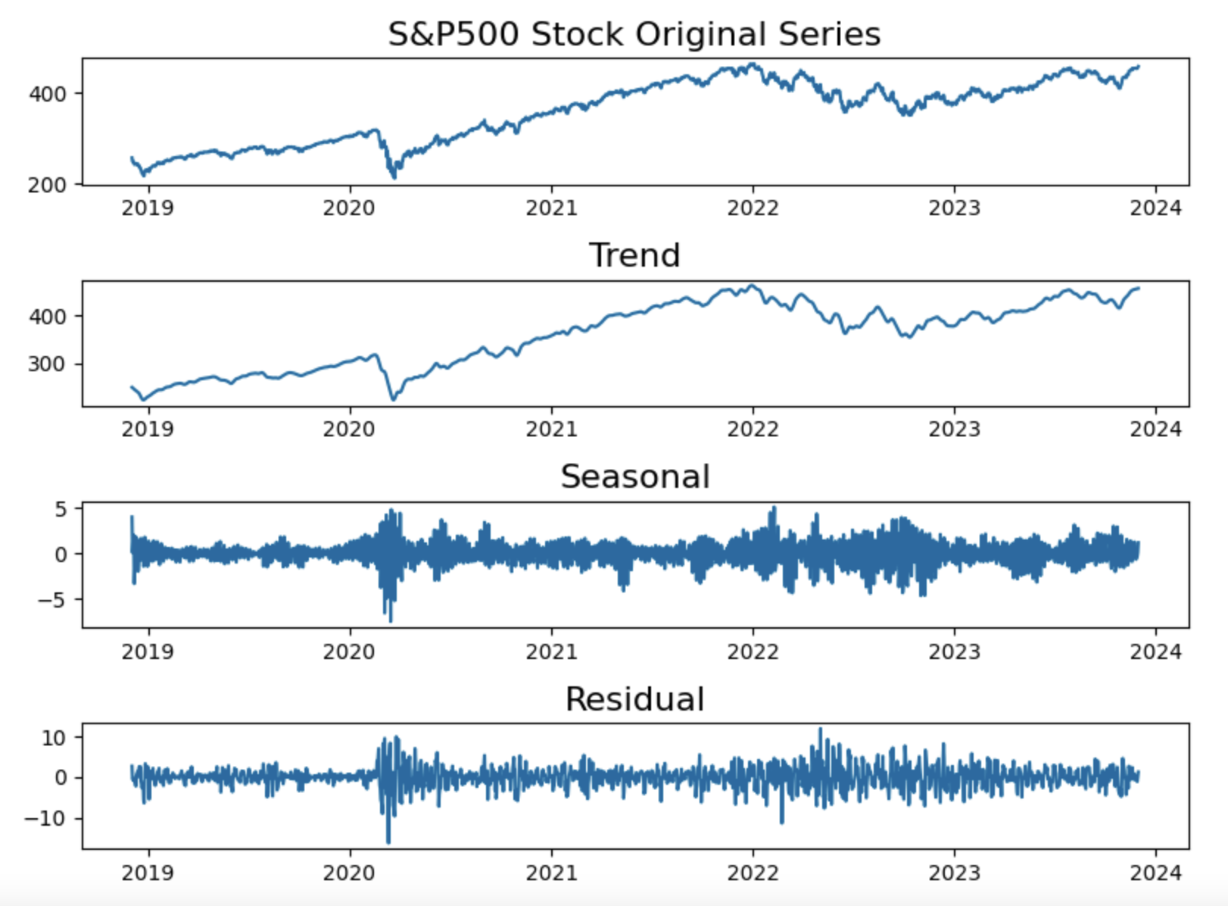
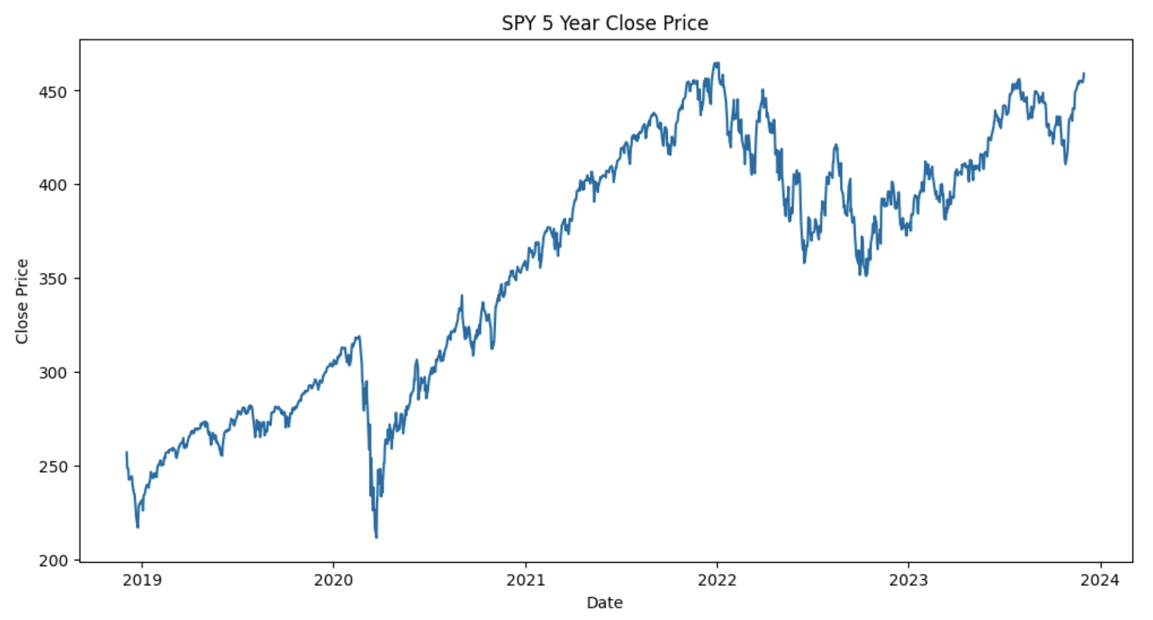
EDA: SPY500 Closing stock prices

Slide 5
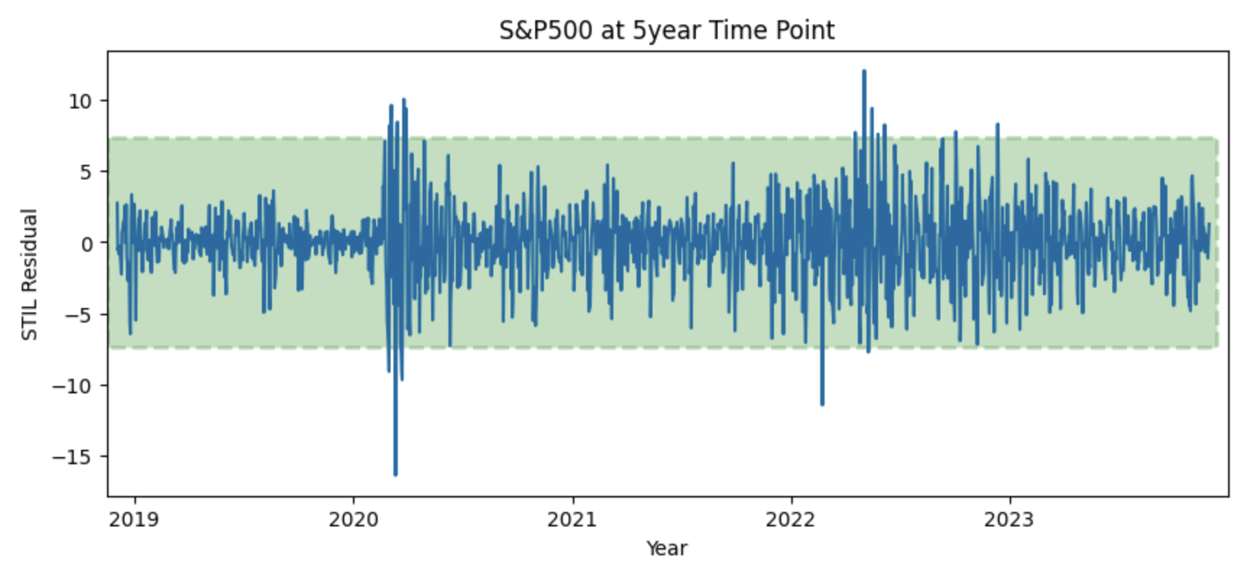
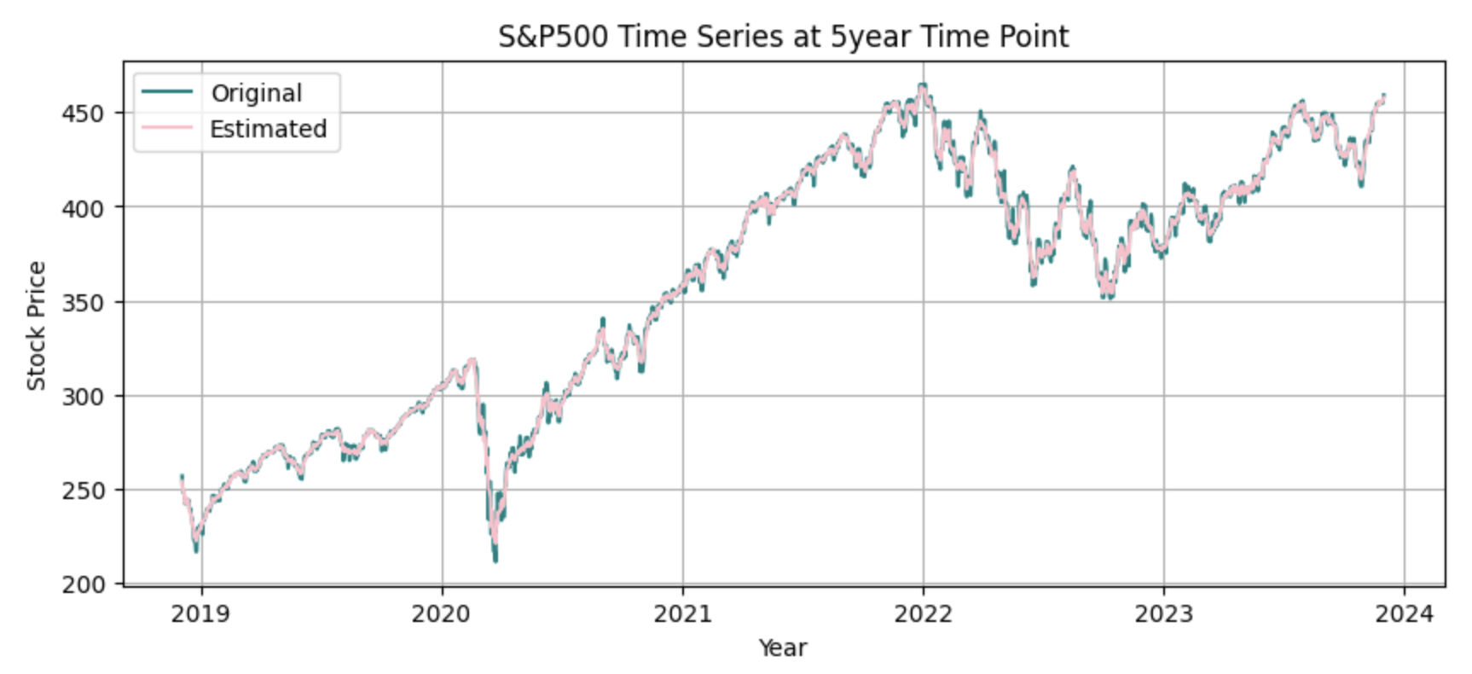
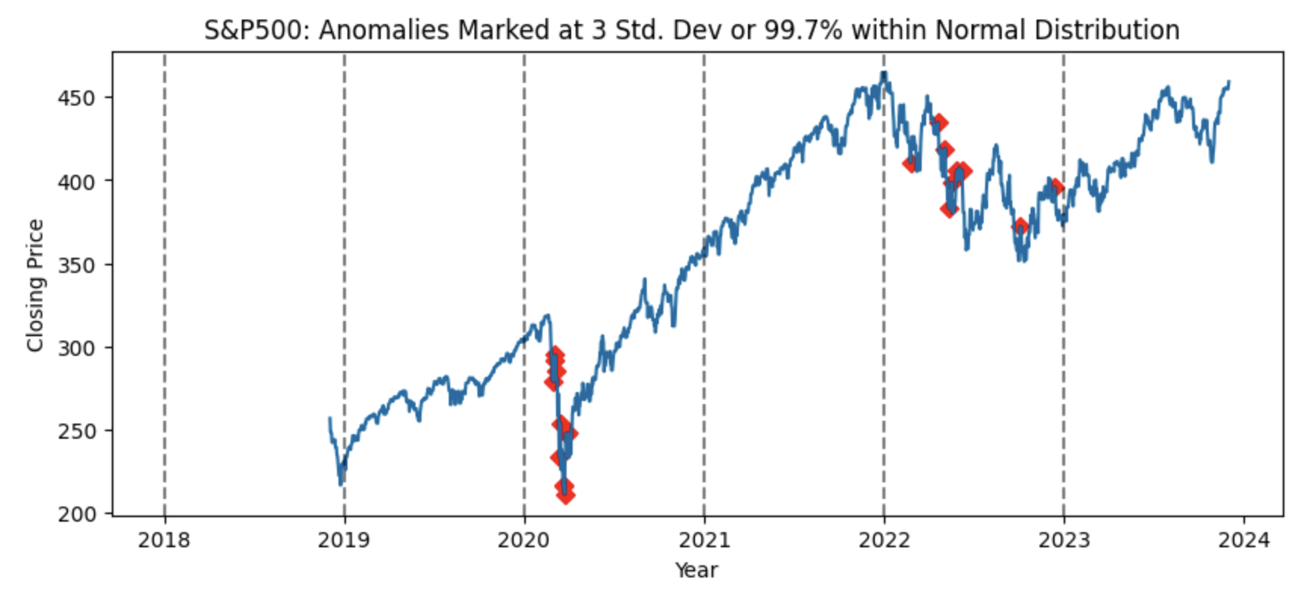
EDA: SPY500 Closing stock prices

Slide 6
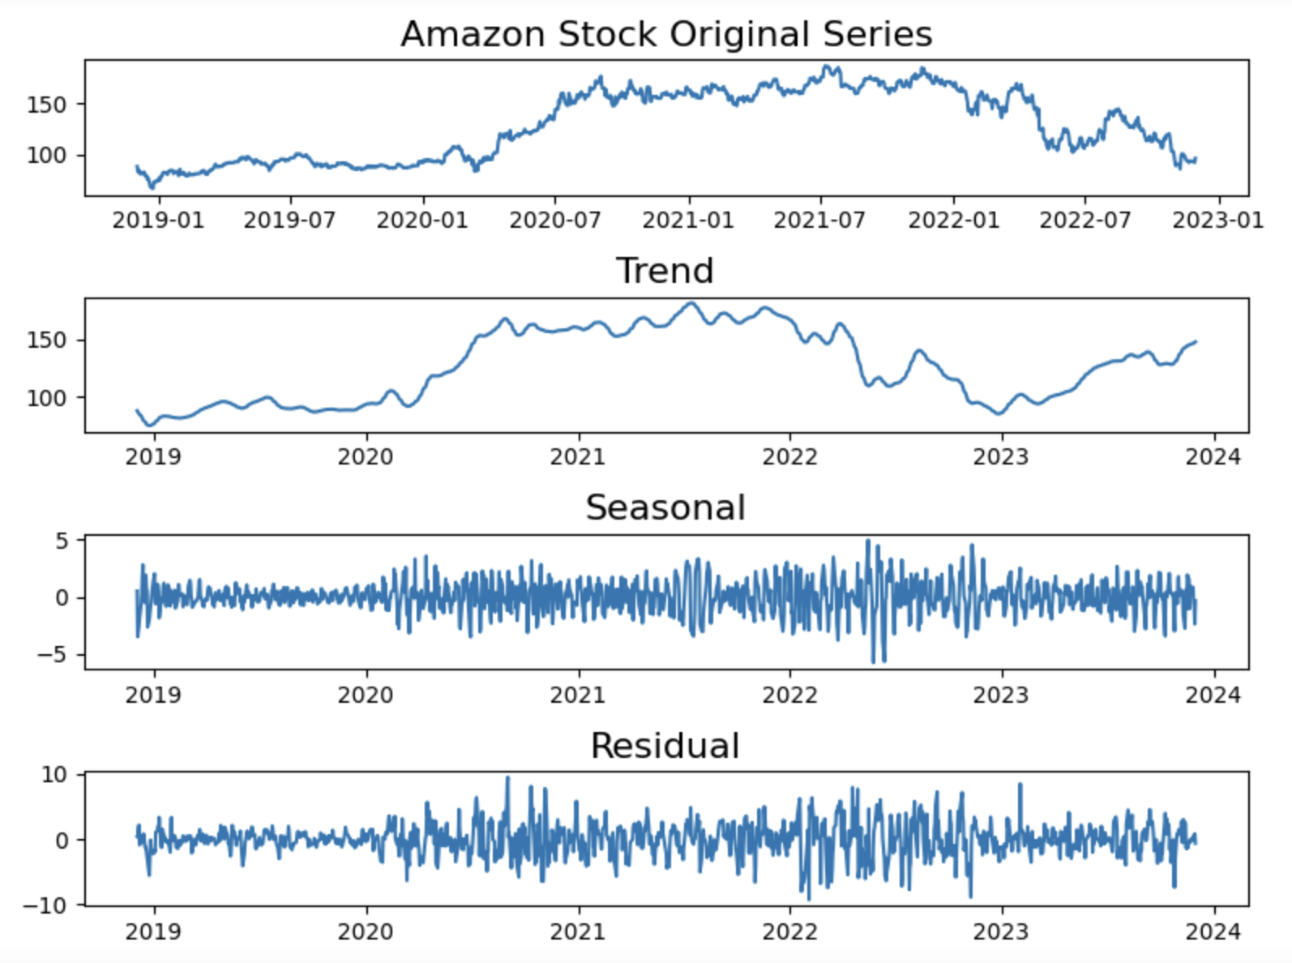
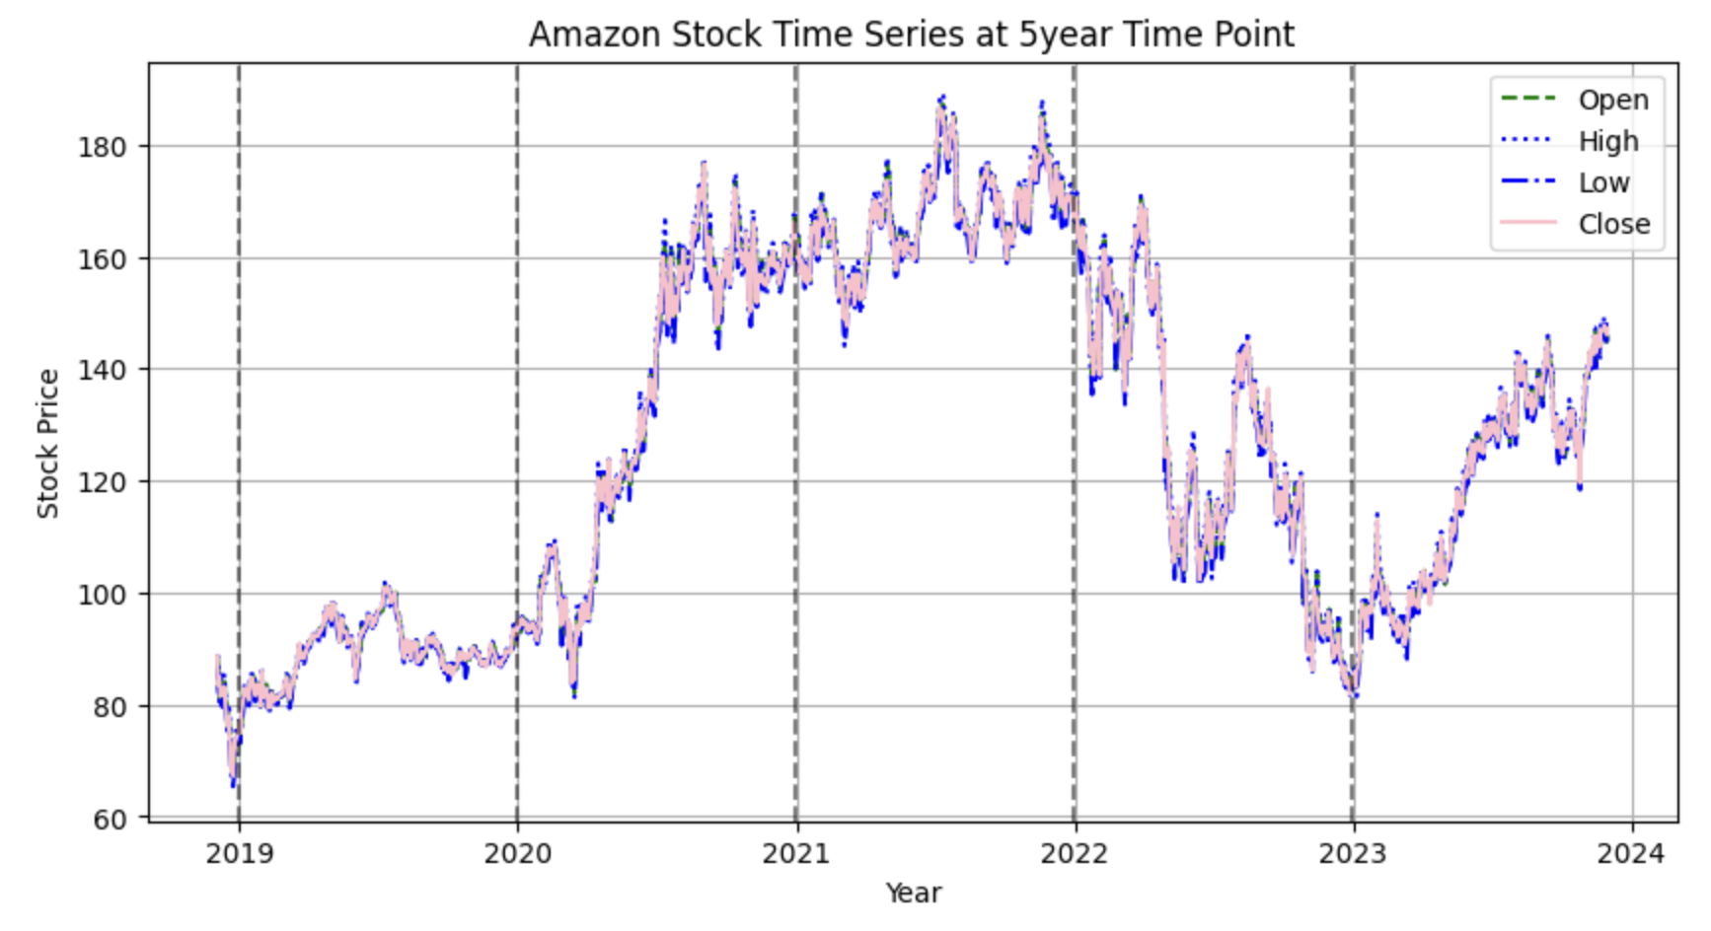
EDA: Amazon Closing stock prices

Slide 7
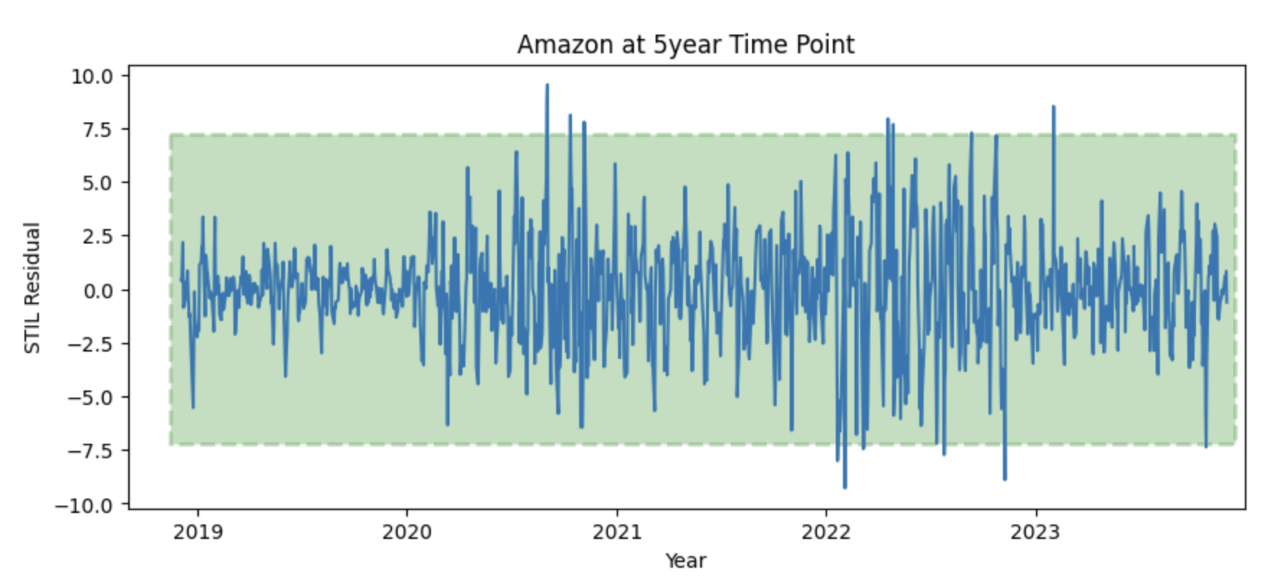
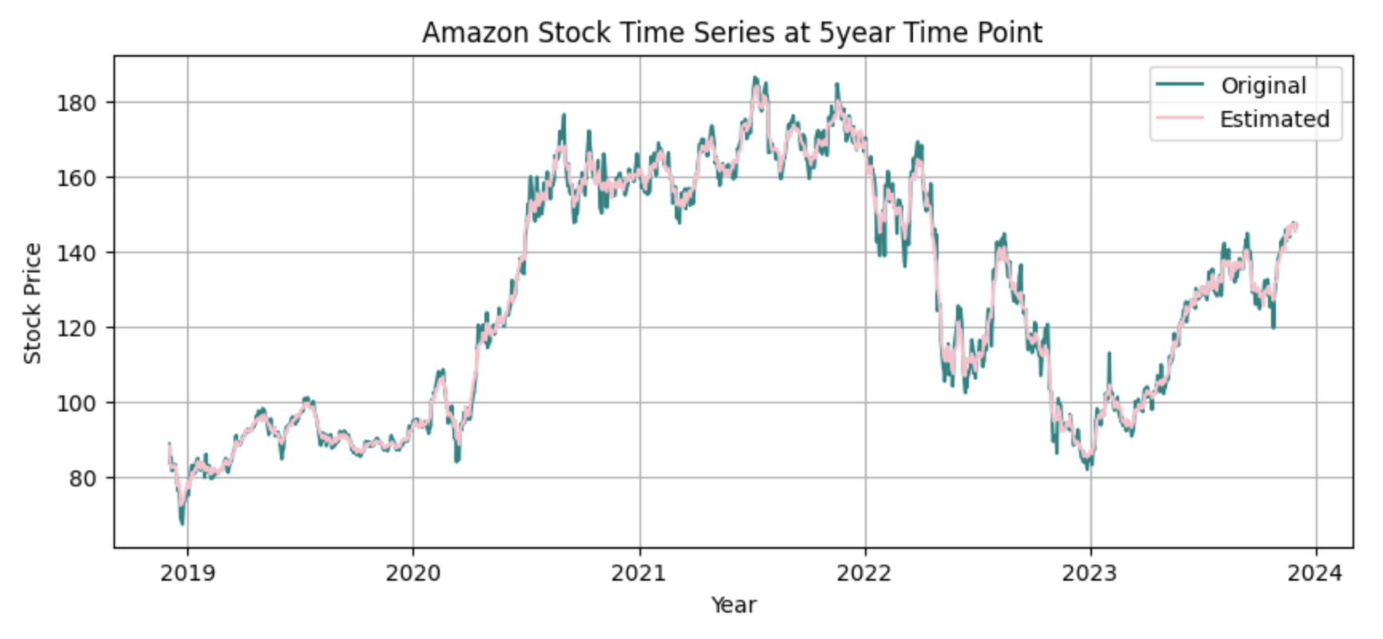
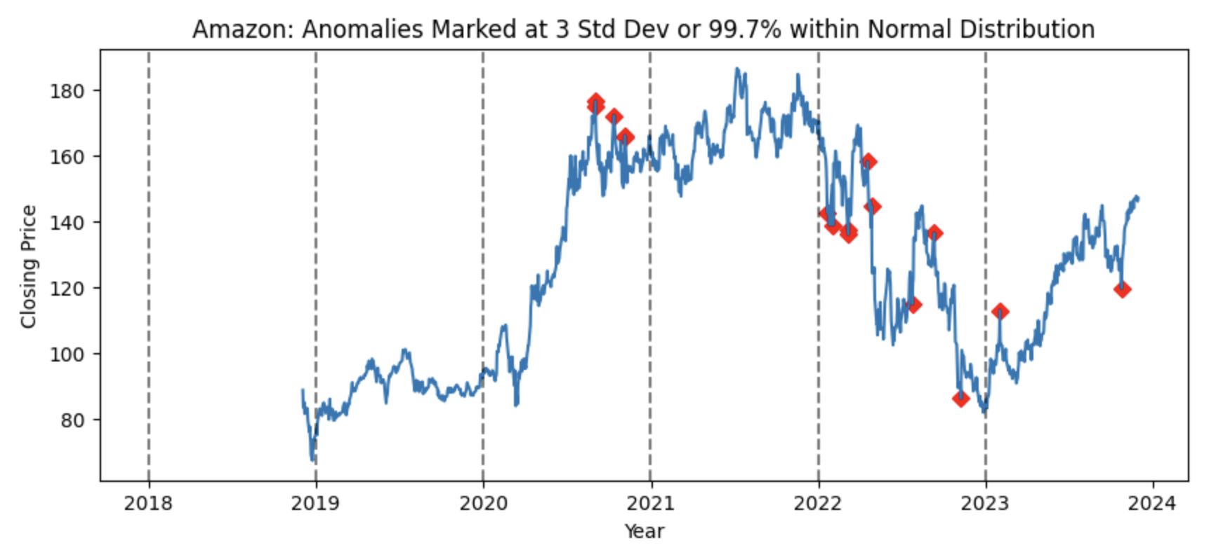
EDA: Amazon Closing stock prices

